Slide 1
Migration

Slide 2
Overview of Business Objectives
Co-existence during migration
Moving from MPLS to any to an elegant future network design
Seamless integration
Minimize service disruption
Allow for new sites to talk to current sites

Slide 3
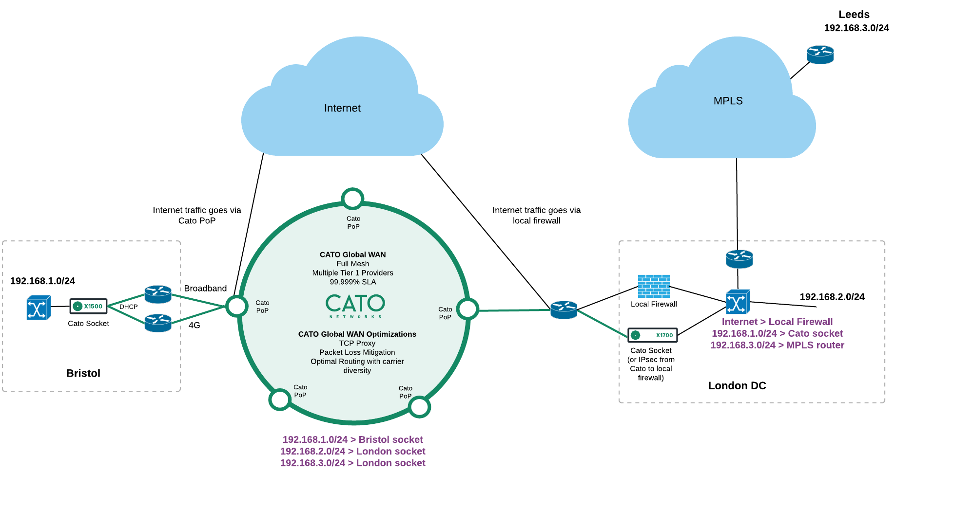
Co-existence during migration

Slide 4
How to

